Slide 1
Polynomial Spectral Pattern
A fixed orthogonal spectral basis (DCT),
with a polynomial (degree-4) linear model on top

Slide 2
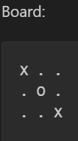

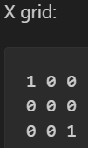
"spectral" pattern on 3×3
One grid for X positions: 1 where X is present, 0 otherwise.
One grid for O positions: 1 where O is present, 0 otherwise

Slide 3
2D Discrete Cosine Transform (DCT)
The DCT decomposes the grid into a sum of patterns:
  A very smooth pattern (almost constant over the whole board).
  Row‑like patterns.
  Column‑like patterns.
  Diagonal or more oscillatory patterns.
3×3 grid gets
9 DCT coefficients per player, so 18 base features total:
DX[u,v] for X’s pattern at frequency (u,v).
DO[u,v] for O’s pattern at frequency (u,v).
Notes:
How much is X concentrated in the center?"
"How much does O form a pattern along a main diagonal?"
"How much does X occupy the top row vs bottom row?"

Slide 4
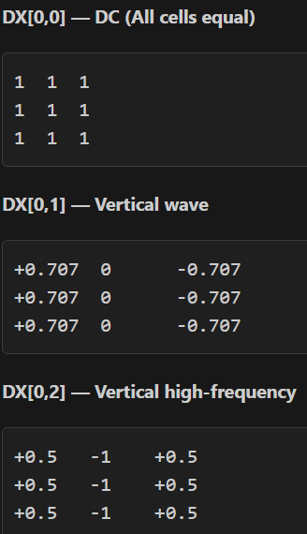
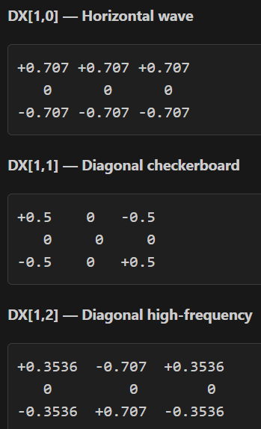
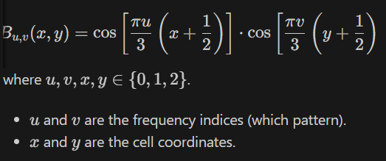
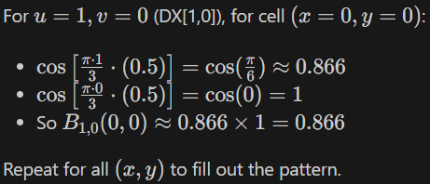

Slide 5

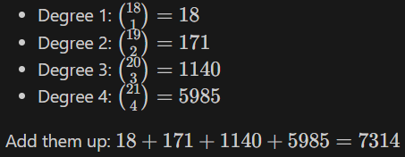
Products of these spectral coefficients
A polynomial of degree 4
A feature vector of length 7314. Each feature is a monomial like:
DX[0,0] – strength of a uniform X pattern.
DX[0,0] * DO[1,2] – interaction between overall X presence and O’s diagonal presence.
DX[2,0] * DX[0,2] * DO[1,1] – higher‑order interaction of three patterns.

Slide 6
Perfect supervision from the exhaustive game tree
Enumerate all legal positions and compute the exact minimax solution
dataset of about 19 121 (state, move) examples, with labels:
1 if the move is minimax‑optimal,
0 otherwise.
score(ϕ)=wTϕ

Slide 7
Test of poly4
98.3% of states where the chosen move is one of the optimal minimax moves.
Gameplay vs random player
93 wins, 7 draws, 0 losses.
Gameplay vs perfect player
0 wins, 100 draws, 0 losses.
Self‑play: policy vs itself
0 wins, 100 draws, 0 losses.

Slide 8
Partial‑data experiment
Fraction of data | Samples used (moves) | Poly4 accuracy | Unique States kept | Vs Random (W/D/L) | Vs Perfect (W/D/L) | Self-play (W/D/L)
0.05 | 956 | 65.0% | 226 | 50 / 0 / 0 | 0 / 25 / 25 | 0 / 50 / 0
0.10 | 1912 | 70.3% | 452 | 48 / 2 / 0 | 0 / 50 / 0 | 50 / 0 / 0
0.20 | 3824 | 70.6% | 904 | 49 / 1 / 0 | 0 / 50 / 0 | 0 / 50 / 0
0.50 | 9560 | 91.9% | 2 260 | 48 / 2 / 0 | 0 / 50 / 0 | 0 / 50 / 0
1.00 | 19121 | 98.3% | 4 520 | 47 / 3 / 0 | 0 / 50 / 0 | 0 / 50 / 0

